Slide 1
Introduction to Machine Learning
Notes:
Humans have been trying to teach computers to perform tasks since their invention. It’s sort of the purpose of a computer, to do something at the level, or beyond what a human can do
Early in the days of computers, many people were convinced that they would achieve human level intelligence within a few decades
It turned out that generalized human intelligence was beyond the grasp of computers at that time (although today, we’re starting to see systems that look a whole lot like human intelligence)

Slide 2
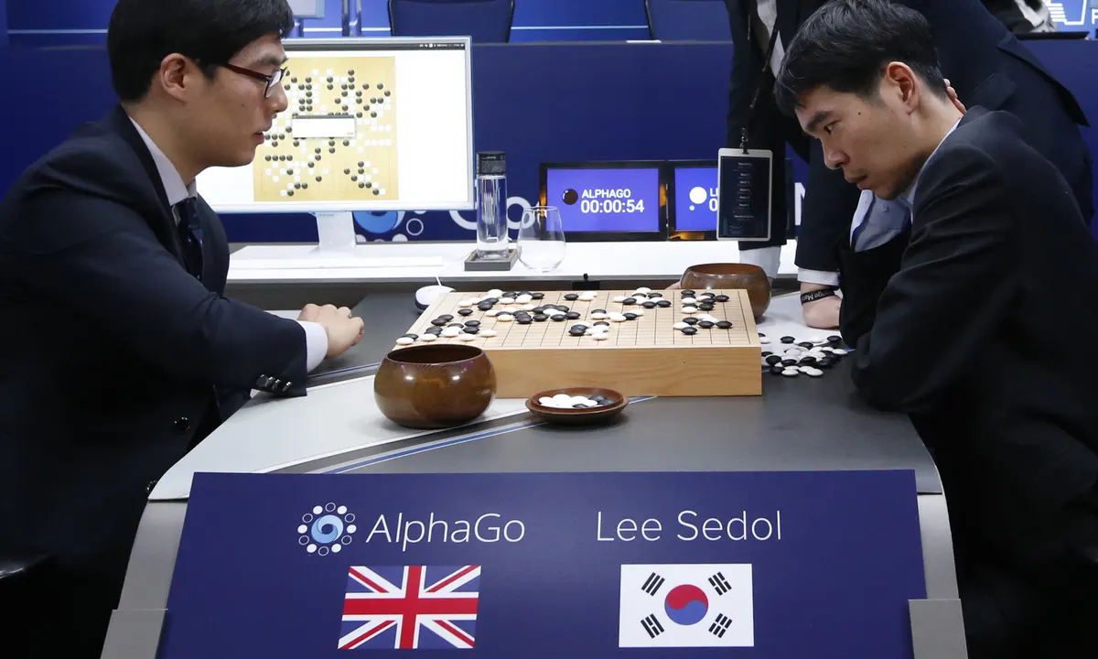
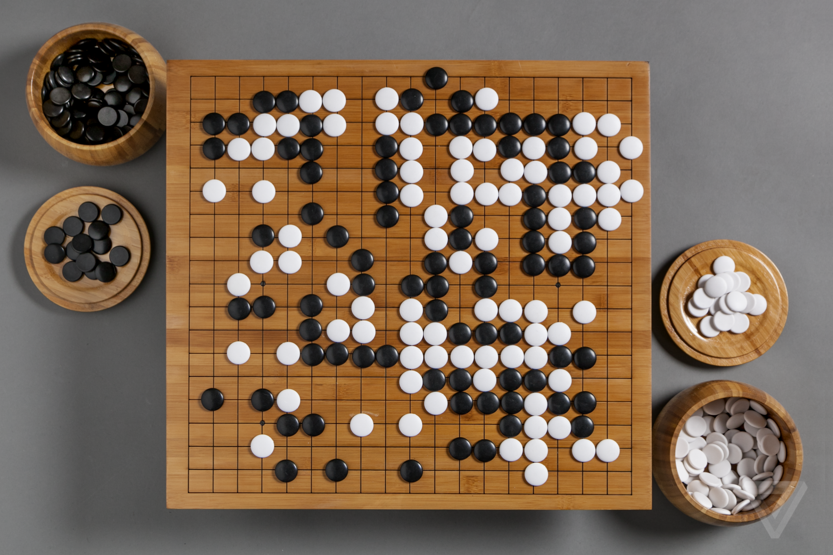
15 March 2016

Slide 3
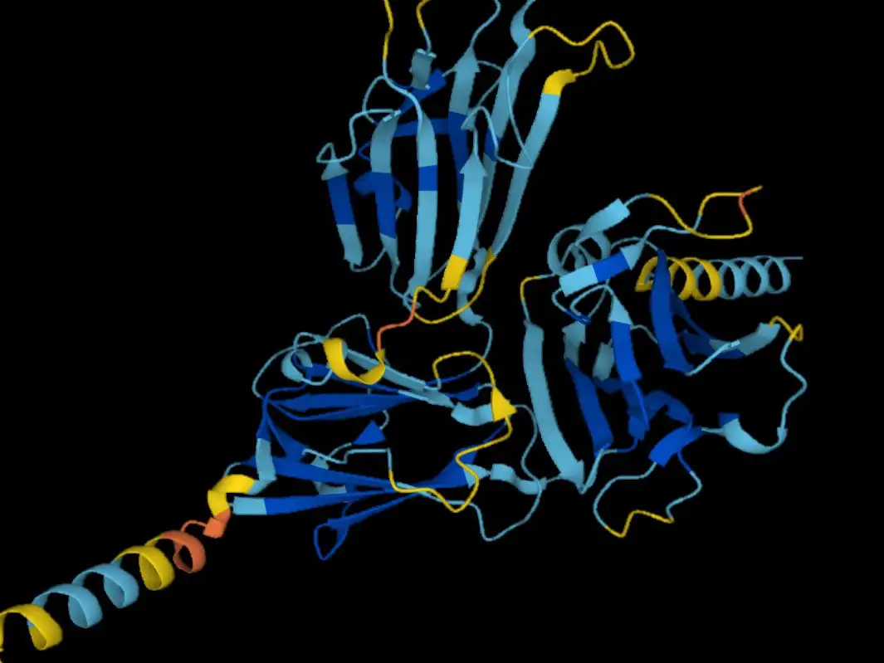
Protein Structure Unfolding (2022) - AlphaFold

Slide 4
Computers made our lives easier!
2007
First iPhone
2008
Google Chrome
2004
Gmail
1998
Apple Macintosh Desktop computer
1978
First spreadsheet program (VisiCalc)
1969
Apollo 11
(Moon landing)
~approx use of commercial computers
1942
Enigma Machine (world war-2)
1892
Simple Calculator

Slide 5
Is every problem is solvable by
rule engine?

Slide 6
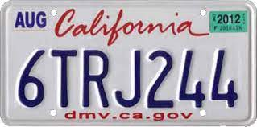
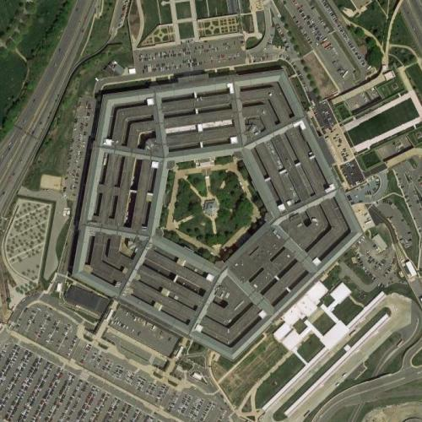
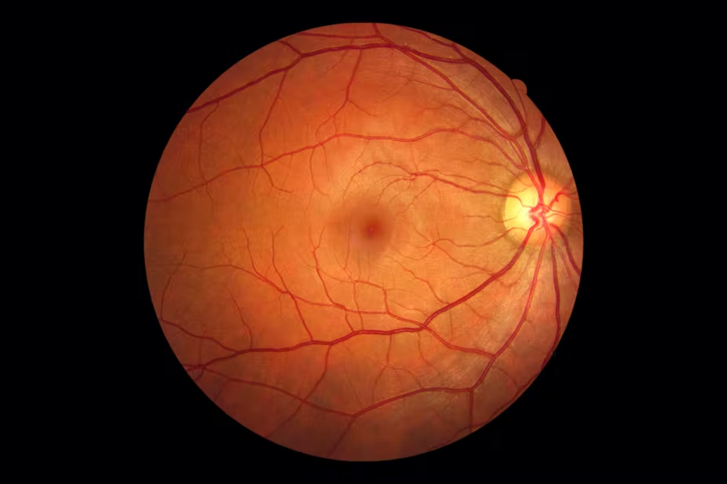
Expert System - Limitations
What are these Images?

Slide 7
Learning through data/examples
As a child, how did you started recognising these images?
Expose to lot of data
Somebody was correcting you over the period of time

Slide 8
Machine Learning is all about learning patterns from data
Exercise 1
2
4
5
6
9
4
16
25
36
81
Guess the function ?

Slide 9
Machine Learning is all about learning patterns from data
Exercise 1
2
4
5
6
9
4
16
25
36
81
Y = X * X

Slide 10
Exercise 2
1.2
0.9
3.2
1.7
2.5
70
50
270120
200
Guess the function ?

Slide 11
Exercise 2
1.2
0.9
3.2
1.7
2.5
70
40
270120
200
Y = X*100 - 50
Computers learning these function approximation is core of Machine Learning!

Slide 12
Type of Machine Learning
Supervised ML
Un-Supervised ML
Reinforcement
Learning

Slide 14
Supervised ML
Regression
Classification

